Slide 1
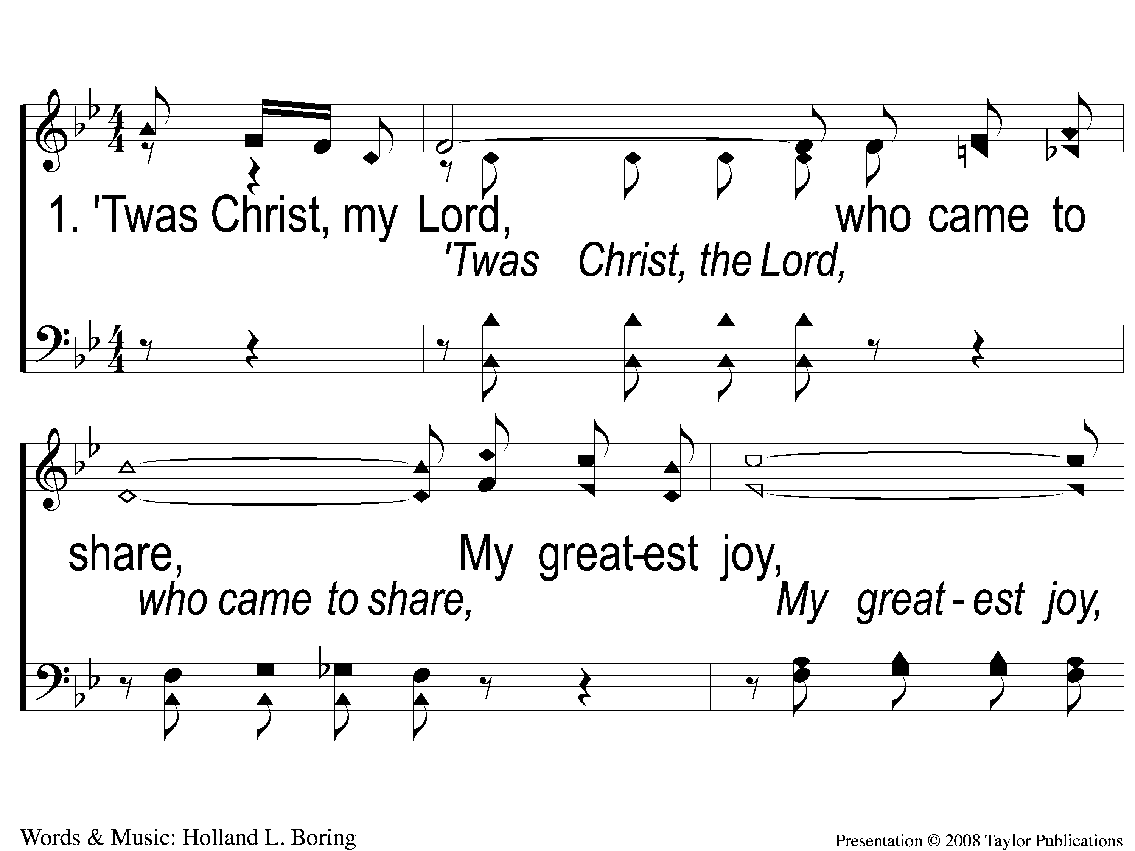
1-1 He is Near
He Is Near
162

Slide 2
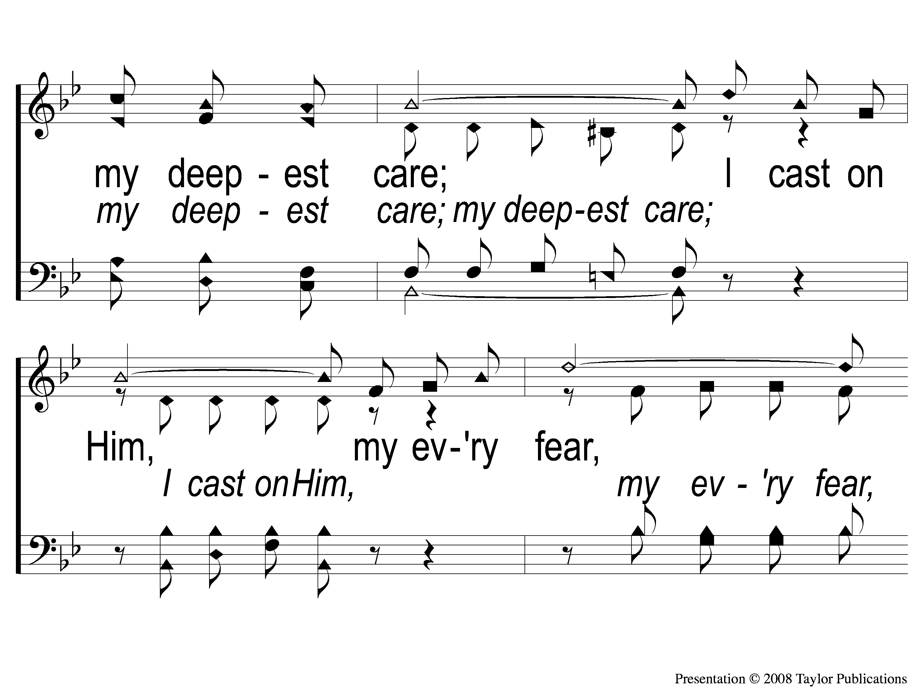
1-2 He is Near
He Is Near
162

Slide 3
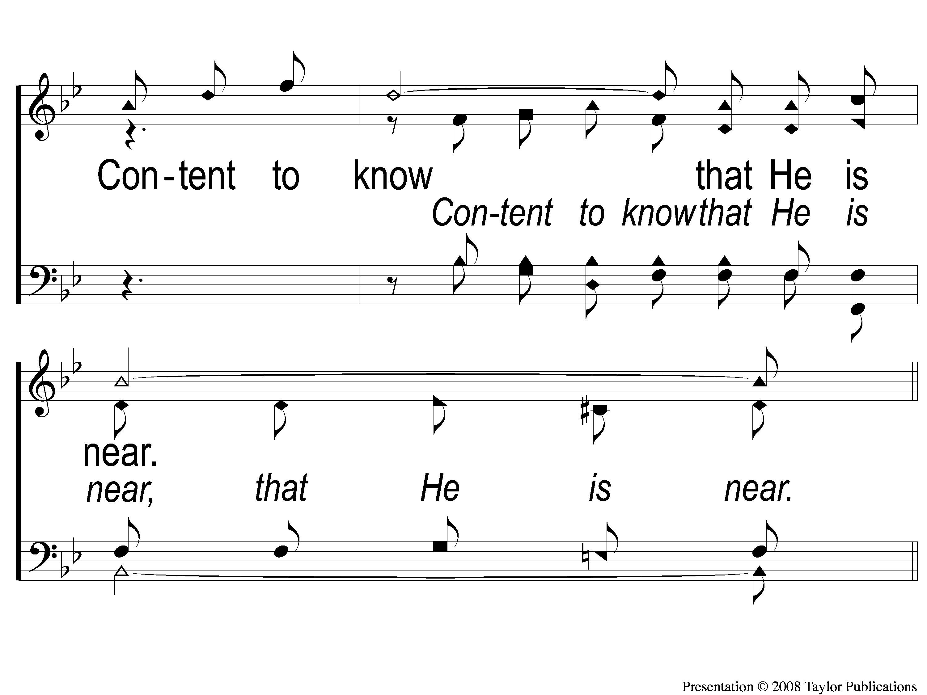
1-3 He is Near
He Is Near
162

Slide 4
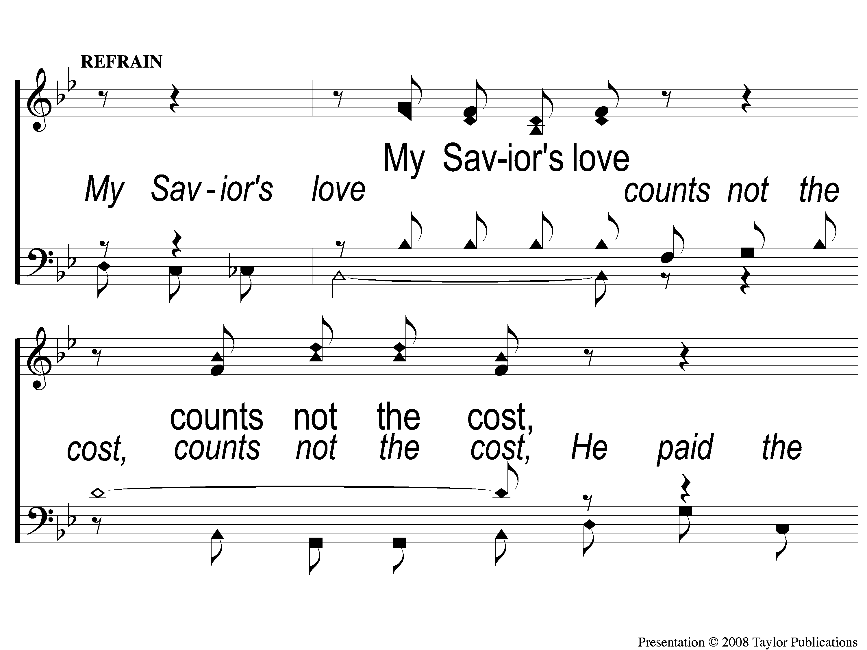
C-1 He is Near
He Is Near
162

Slide 5
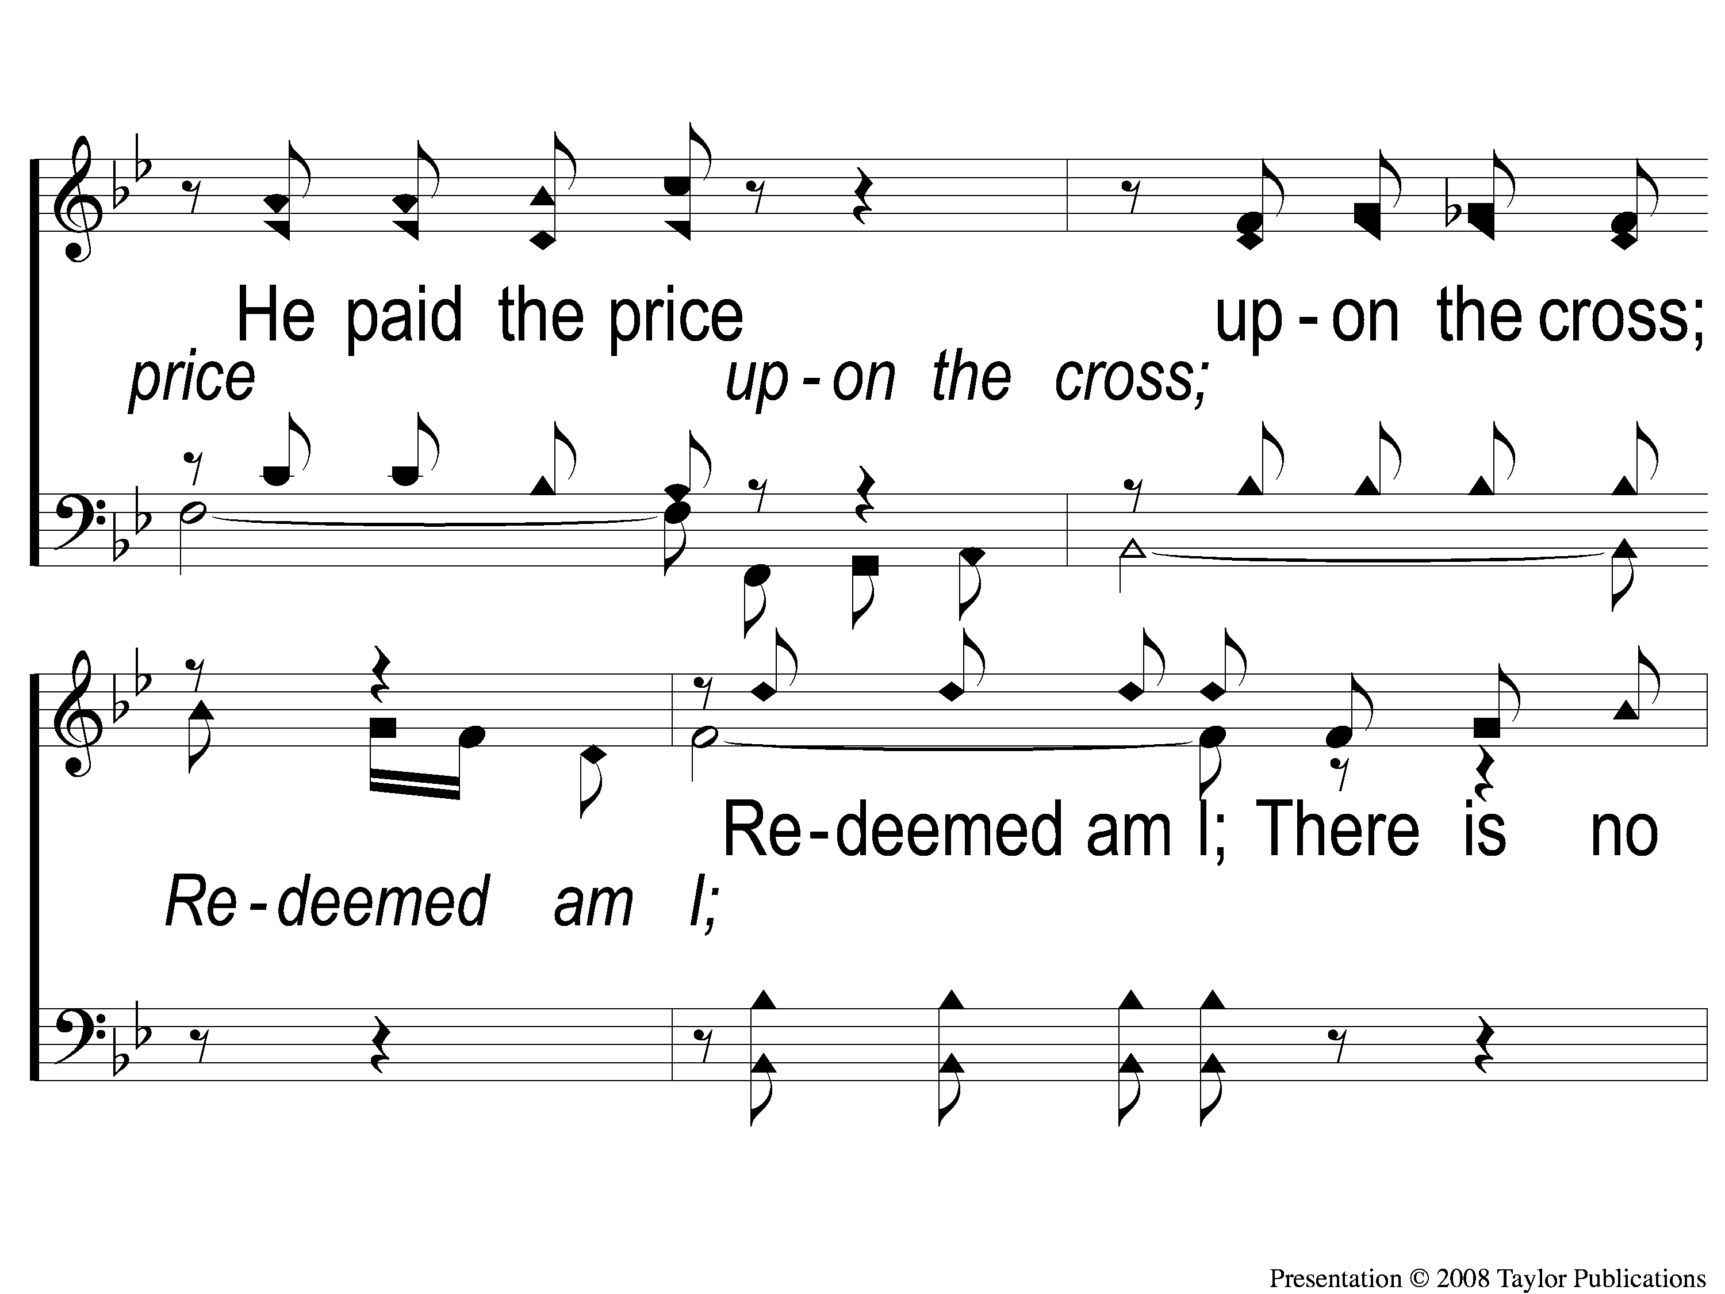
C-2 He is Near
He Is Near
162

Slide 6
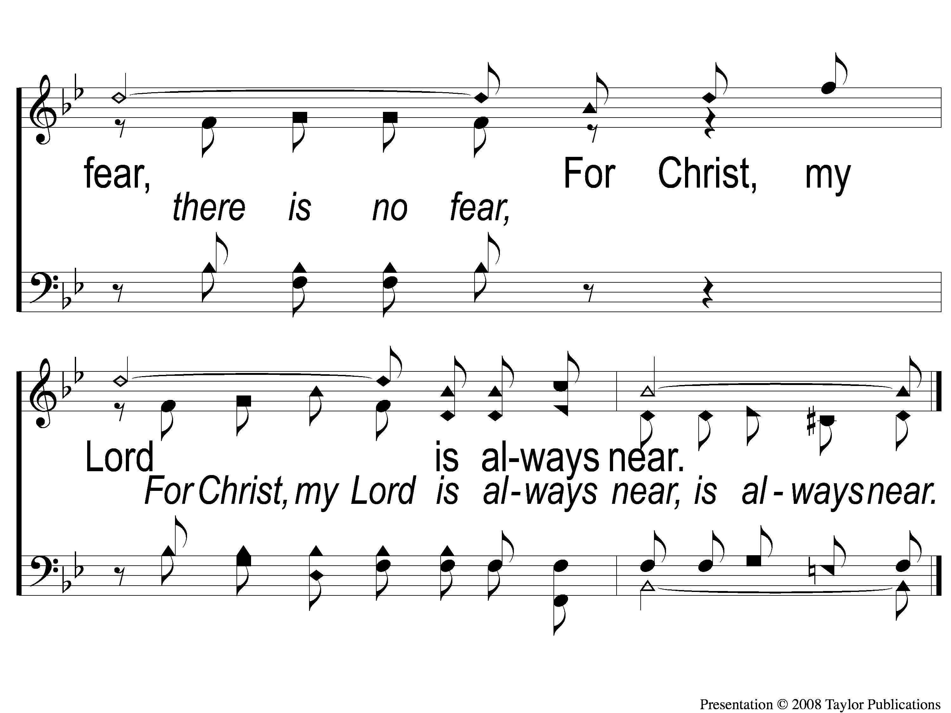
C-3 He is Near
He Is Near
162

Slide 7
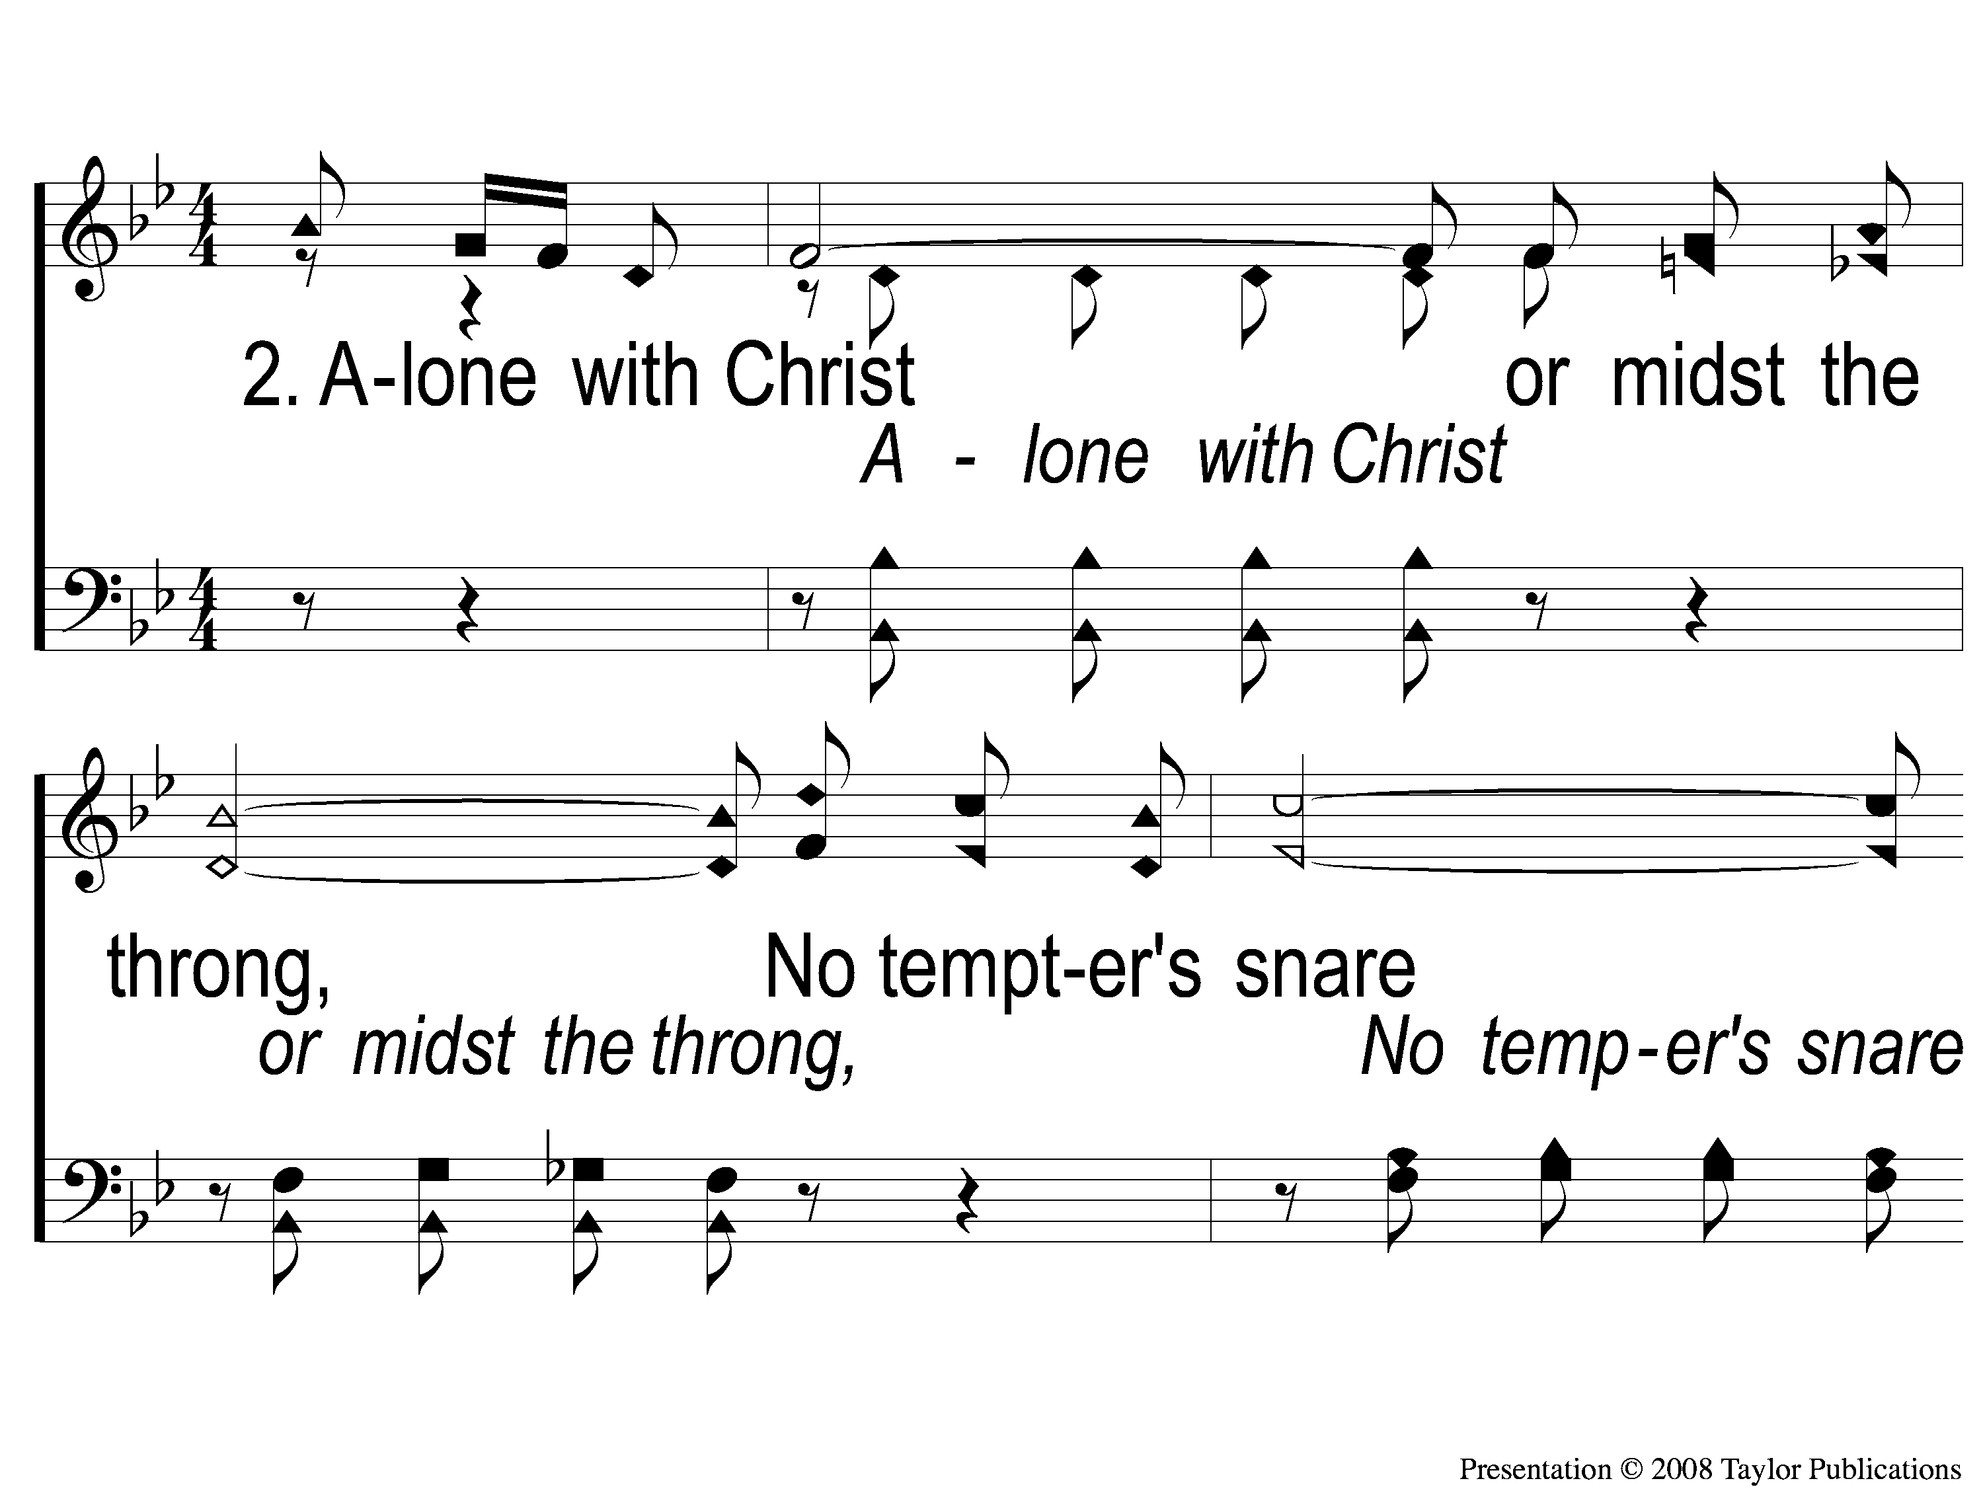
2-1 He is Near
He Is Near
162

Slide 8
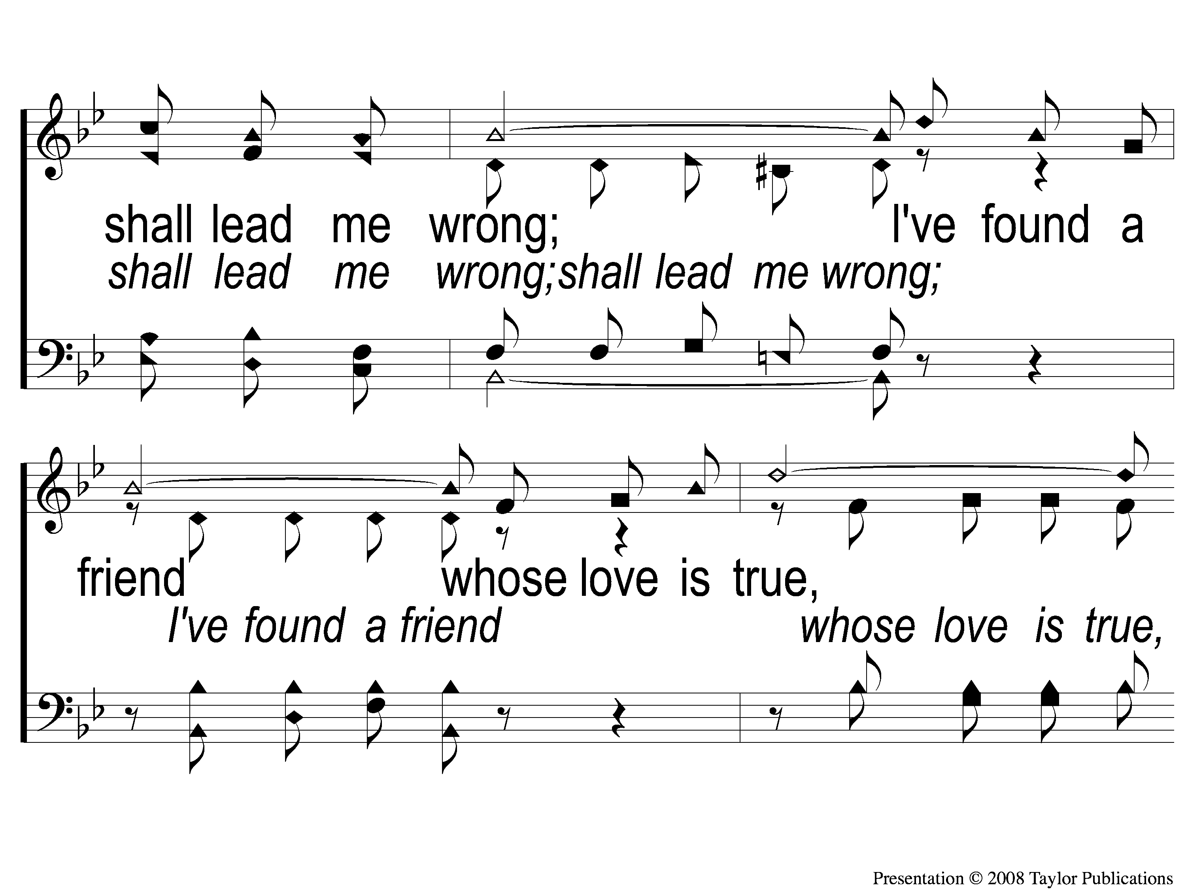
2-2 He is Near
He Is Near
162

Slide 9
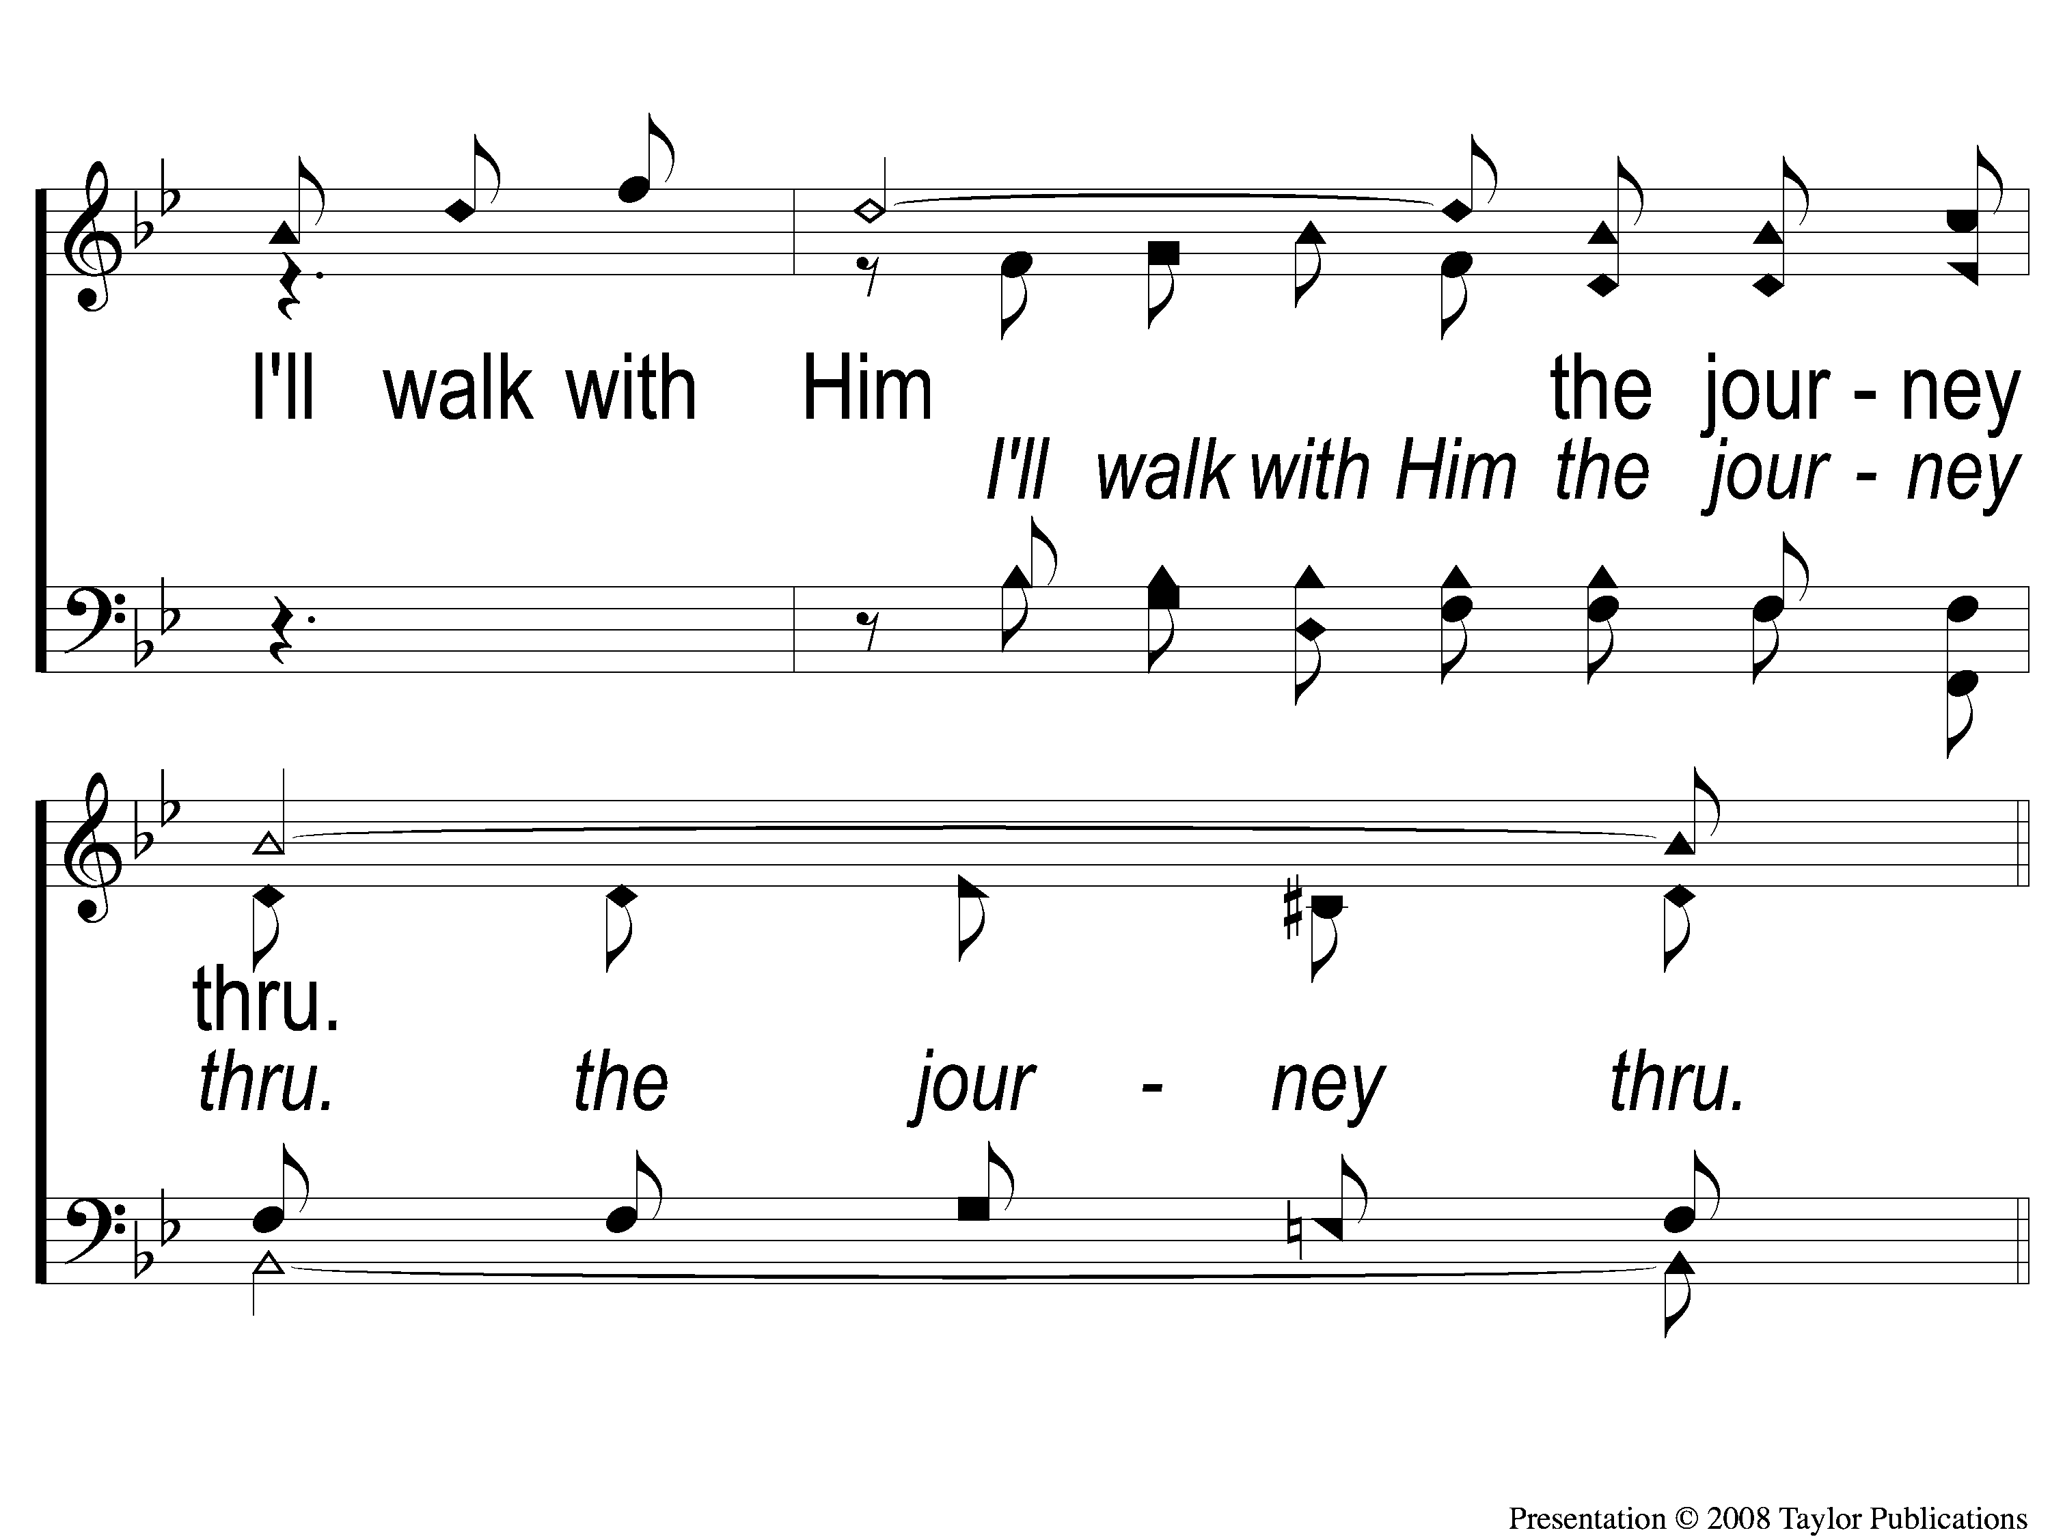
2-3 He is Near
He Is Near
162

Slide 10
C-1 He is Near
He Is Near
162

Slide 11
C-2 He is Near
He Is Near
162

Slide 12
C-3 He is Near
He Is Near
162

Slide 13
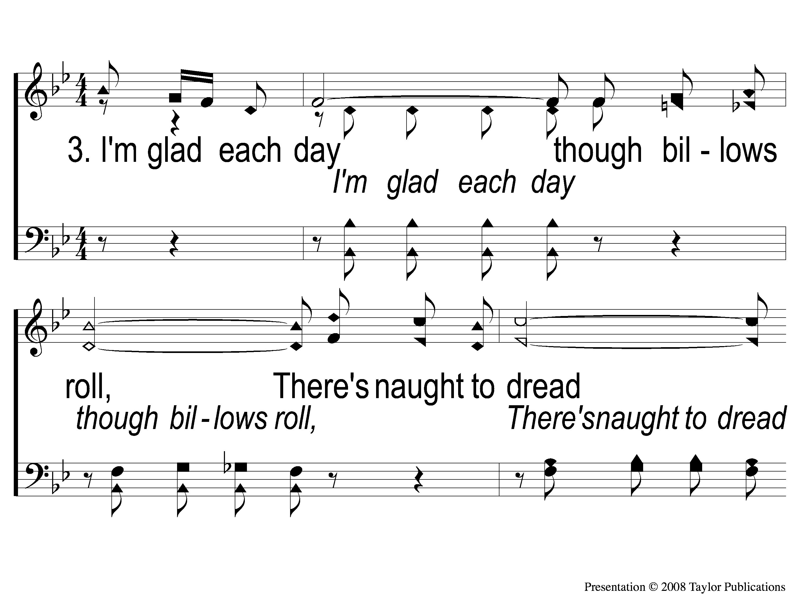
3-1 He is Near
He Is Near
162

Slide 14
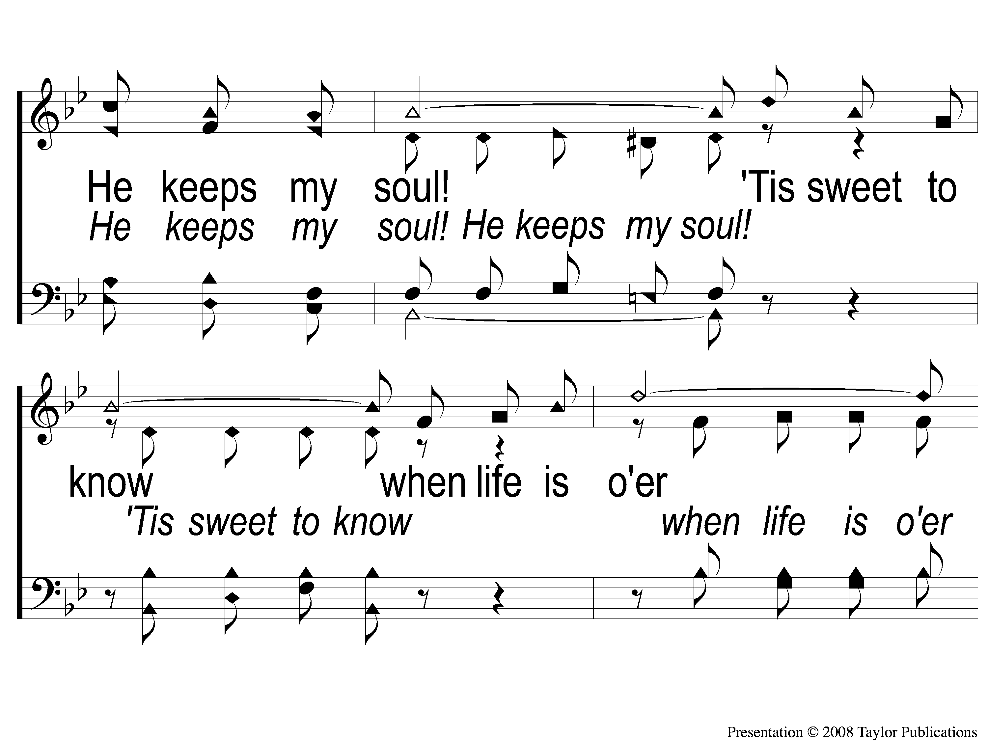
3-2 He is Near
He Is Near
162

Slide 15
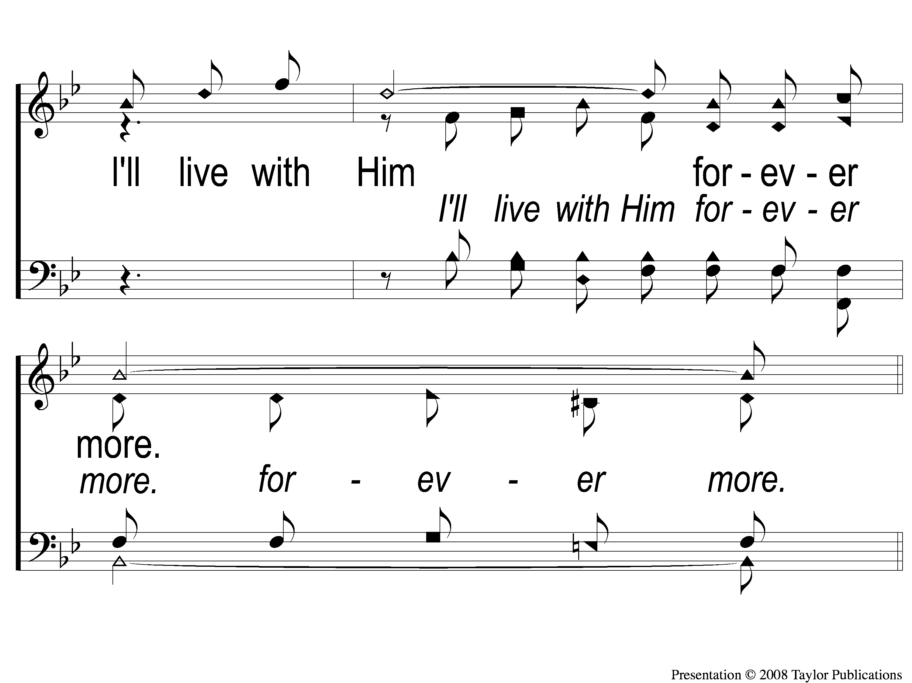
3-3 He is Near
He Is Near
162

Slide 16
C-1 He is Near
He Is Near
162

Slide 17
C-2 He is Near
He Is Near
162

Slide 18
C-3 He is Near
He Is Near
162

